Slide 1
Data Science Introduction
Dave Wentzel
linkedin.com/in/dwentzel
git.davewentzel.com/demos/datasciencehack

Slide 2
Session Takeaways
“As a Data Professional, I’d like to know how to work better with data scientists.”
“As a Data Professional, I’d like a better grounding in the fundamentals of data science.”
INTERRUPT me at ANY time!

Slide 3
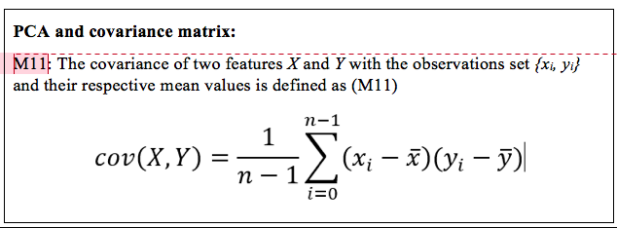
We Need to Start By Understanding Statistics

Slide 4
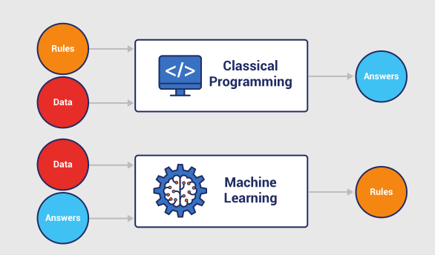
The Model-Driven Enterprise
Software 2.0

Slide 5
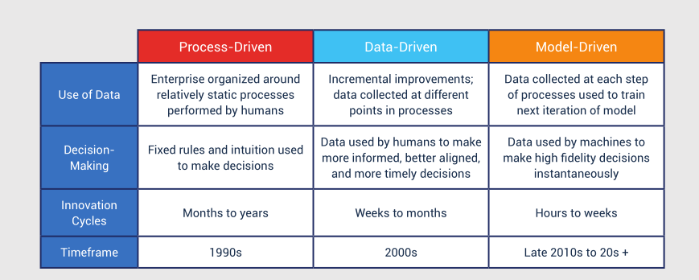

Slide 6
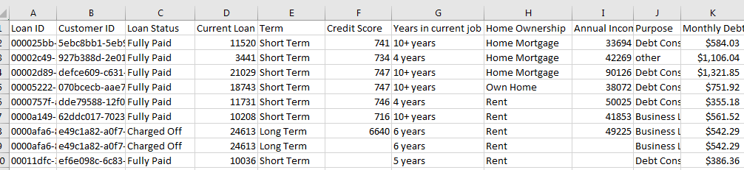
Understanding the “Shape” of Data
Will this loan be charged off?

Slide 7
Terminology
Training Data : A set of samples (table of data)
Testing Data: A set of samples (training data) set aside to test your model
Features: Individual columns in our data set. These might be used to help make our prediction, or not.
Factors: aka features
Categorical Features: features with a known domain of values
independent variables: aka features
Feature Engineering: manipulating existing data to make it more meaningful
very similar to ETL
Data Wrangling/Munging: ETL
Data Dredging: make the data fit the hypothesis (don’t do this)
Label: Historical outcome or result related to a set of samples.
What you are trying to predict.
aka, “the target” or “the dependent variable”, or “response”
Notes:
Spurious correlations
annual income by education level (not understanding control variables)
golf causes more health problems (again, not controlling for age).

Slide 8
Feature Engineering Tasks
Improve model performance
Faster & effective
Better understanding
Some features are not observable
Domain knowledge
Feature Selection
Feature Generation
Clean Missing Data
Feature Transformation
Missing values are very common
It has a significant effect on the conclusion
Data is skewed
Input is in wrong data type

Slide 9
Terminology
Learner: Machine learning algorithm
Supervised Learning: we know the label (”will this loan chargeoff?”)
you “train” these models with training and test data
Unsupervised Learning: we don’t know the label (“Recommendation engines”)
the learner tries to find patterns
ex: anomaly detection, clustering
Parameter / Hyper-parameter
Correlation vs Causation: ML *cannot* tell what caused what
Leakage
you accidentally used the response to predict the response
(you used the answer to predict the answer)
ex: you use GPA to predict if a student will fail
these are often “masked” or “derived” and are hard to find
happens possibly when your “relative influence” gets to high (70%?)
Notes:
Spurious correlations

Slide 10
Terminology
Overfitting/Underfitting a model
the more you try to make your model perfect, the more you risk fitting the model to the training data and the model begins to memorize the data it has seen.
If it walks like a duck and talks like a duck, it’s a duck
It is a duck if, and only if, it walks and quacks exactly in the ways I have personally observed from ducks in Pennsylvania. Since I’ve never observed ducks in Australia, that may look, walk and quack differently from ducks in PA…in that case, they aren’t ducks at all.
If it walks on two legs and emits shrill, nasal-y, high pitched noises, it’s a duck. Therefore, Fran Drescher is a duck.
Notes:
Spurious correlations

Slide 11
Data science questions
How much / how many? Regression
supervised. ”Given my past sales, what will my sales be next quarter”
2. Which category? Classification
supervised. “Will this loan chargeoff”
3. Which groups? Clustering
4. Is it weird? Anomaly Detection
5. Which option? Recommendation

Slide 12
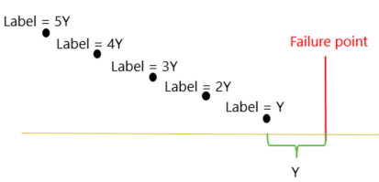
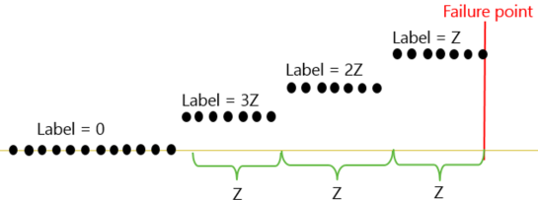
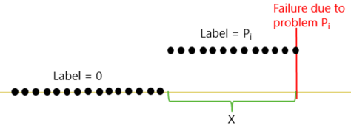
Modelling Techniques – Predictive Maintenance
Regression
Classification
E.g. How long will an aircraft engine last before it fails? (RUL)
E.g. Will the engine fail? Due to compressor or rotor blade?
You can use either, they both generate a number

Slide 13
Data Labeling
id | cycle | … | RUL | label1 | label2
1 | 1 |  | 191 | 0 | 0
1 | 2 |  | 190 | 0 | 0
1 | 3 |  | 189 | 0 | 0
1 | 4 |  | 188 | 0 | 0
… |  |  | … | … | …
1 | 160 |  | 32 | 0 | 0
1 | 161 |  | 31 | 0 | 0
1 | 162 |  | 30 | 1 | 1
1 | 163 |  | 29 | 1 | 1
1 | 164 |  | 28 | 1 | 1
1 | 165 |  | 27 | 1 | 1
1 | 166 |  | 26 | 1 | 1
1 | 167 |  | 25 | 1 | 1
1 | 168 |  | 24 | 1 | 1
1 | 169 |  | 23 | 1 | 1
1 | 170 |  | 22 | 1 | 1
1 | 171 |  | 21 | 1 | 1
1 | 172 |  | 20 | 1 | 1
1 | 173 |  | 19 | 1 | 1
1 | 174 |  | 18 | 1 | 1
1 | 175 |  | 17 | 1 | 1
1 | 176 |  | 16 | 1 | 1
1 | 177 |  | 15 | 1 | 2
1 | 178 |  | 14 | 1 | 2
1 | 179 |  | 13 | 1 | 2
1 | 180 |  | 12 | 1 | 2
1 | 181 |  | 11 | 1 | 2
1 | 182 |  | 10 | 1 | 2
1 | 183 |  | 9 | 1 | 2
1 | 184 |  | 8 | 1 | 2
1 | 185 |  | 7 | 1 | 2
1 | 186 |  | 6 | 1 | 2
1 | 187 |  | 5 | 1 | 2
1 | 188 |  | 4 | 1 | 2
1 | 189 |  | 3 | 1 | 2
1 | 190 |  | 2 | 1 | 2
1 | 191 |  | 1 | 1 | 2
1 | 192 |  | 0 | 1 | 2
Predefined window size for classification models
w1 = 30
w0 = 15
Regression
Binary classification
w1
Multi-class classification
w0

Slide 14
“ Feature engineering is the most important but underrated step of machine learning.”
Better features are better than better algorithms…
Better features are better than more data...
More data is better than better algorithms...

Slide 15
Feature Engineering is... having a toolbox of “tricks” obsessively knowing your data and your industry Data Acquisition is the Number One Reason why data science projects either succeed or fail. As Data Professionals we need to help our data scientists make the best use of data. They often don’t know the data as well as we do. The average R script is 80% ETL, 20% model. That is WRONG. We must help our data scientists.

Slide 16
Clean Missing Data
Remove missing data
Delete all rows that contain missing values
Delete the column which contains missing values
Replace missing values with a new value
Categorical data: create a new missing category
Numerical data has many approaches to replace missing values
Replace using MICE (Multiple Imputation by Chained Equations)
Replace with mean
Replace with median
Replace with mode
Replace with probabilistic PCA
Custom substitution value (domain knowledge)
Notes:
use the mean when the data is tightly normally distributed
median if the data has fat tails (outliers)
mode (most common value) if you have predominantly a single discrete value that occurs most often

Slide 17
Feature Engineering Best Practices
handle missing data
consider changing your data model
time series
always do data profiling. Find outliers, understand your data
You’ll likely have a dataset of hundreds or thousands of feature candidates. That doesn’t mean your model should use them all. Most models work best with a handful of REALLY GOOD curated features.

Slide 18

Feature Engineering Best Practices – Handling Continuous Numerical Values
Categorical features are always better
the algorithm isn’t wasting time trying to determine if there are meaningful patterns to continuous numeric data
if possible:
make a continuous variable a discrete variable
then use “banding”
then use one-hot encoding
Regardless, when using a continuous variable, “squash” it with a sigmoid function.
Why are we doing this?

Slide 19
Feature Generation
Time Stamp | Sensor
11/16/2016 13:25 | 34
11/16/2016 13:26 | 35
11/16/2016 13:27 | 32
11/16/2016 13:28 | 33
11/16/2016 13:29 | 25
11/16/2016 13:30 | 23
11/16/2016 13:31 | 28
11/16/2016 13:32 | 34
11/16/2016 13:33 | 35
11/16/2016 13:34 | 35
11/16/2016 13:35 | 34
11/16/2016 13:36 | 34
… | …
11/18/2016 23:59 | 34
Time Stamp
Sensor
Lag1
Lag2
Lag3
Rolling
Avg
11/16/2016 13:25
34
11/16/2016
13:26
35
34
11/16/2016
13:27
32
35
34
11/16/2016
13:28
33
32
35
34
33.7
11/16/2016
13:29
25
33
32
35
33.3
11/16/2016
13:30
23
25
33
32
30.0
11/16/2016
13:31
28
23
25
33
27.0
11/16/2016
13:32
34
28
23
25
25.3
11/16/2016 13:33
35
34
28
23
28.3
11/16/2016 13:34
35
35
34
28
32.3
11/16/2016 13:35
34
35
35
34
34.7
11/16/2016 13:36
34
34
35
35
34.7
…
…
…
…
…
…
11/18/2016 23:59
34
35
34
34
34.3

Slide 20
Example Feature Engineering Methods
1- Rolling aggregates:
For each labelled record of an asset, pick a rolling window of size w, compute rolling aggregate features for the periods before the labelling date and time of that record.
Create features that capture degradation over time.
2- Lag features for short term:
For each labelled record of an asset, pick a window of size w and use tumbling windows to create aggregate features for the periods before the labelling date and time.
3- Lag features for long term:
For each labelled record, find aggregated features for a larger window than w reflecting the long term effects.
Notes:
studio.azureml.com
dave@davewentzel.com: personal
Loan Granting Binary Classifcation

Slide 21
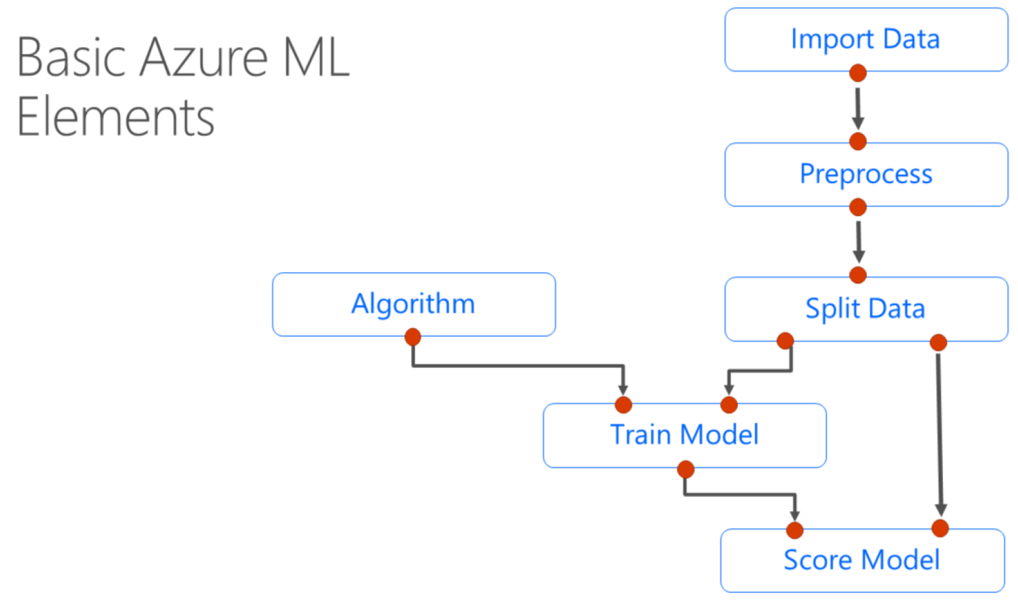
Azure ML

Slide 22
Bias
Learners are biased toward the majority class
Minority class tends to be misclassified
Solution: Smart oversampling of the minority class with random undersampling of the majority class
SMOTE: Synthetic Minority Oversampling Technique
Examples:
failure detection
fraud analysis

Slide 23
Closing Thoughts on Maintaining a Toolbox of Tricks
CRAN
Learn to love trial and error
Learn to iterate QUICKLY
Study probability and statistics
Never stop learning your domain
Don’t go right to R or AML, visual your data and profile it first. Learn your data.

Slide 24
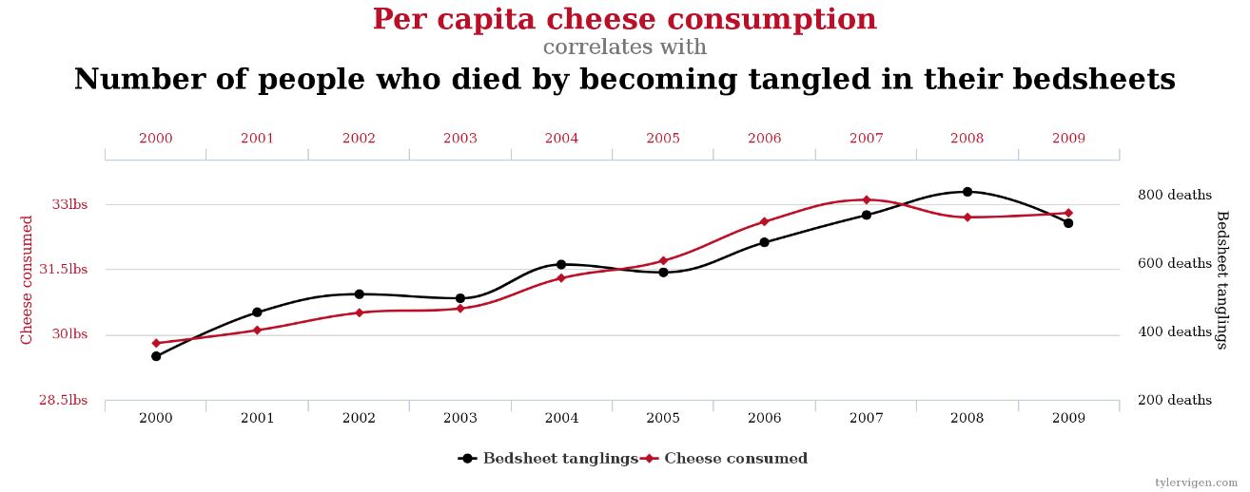
Caution!
Machine learning can’t tell what caused what.
http://www.tylervigen.com/spurious-correlations

Slide 25
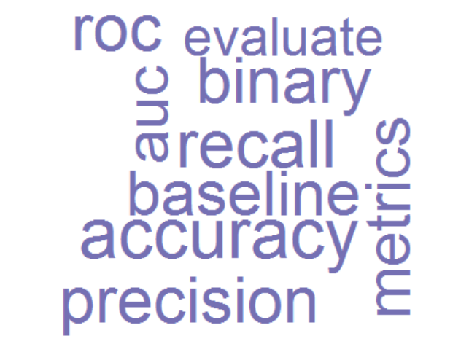
Model Evaluation
recall
accuracy
precision

Slide 26
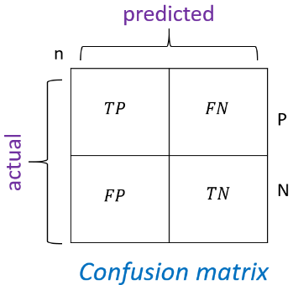
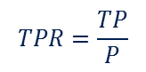
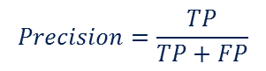
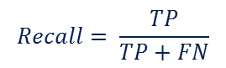
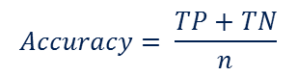
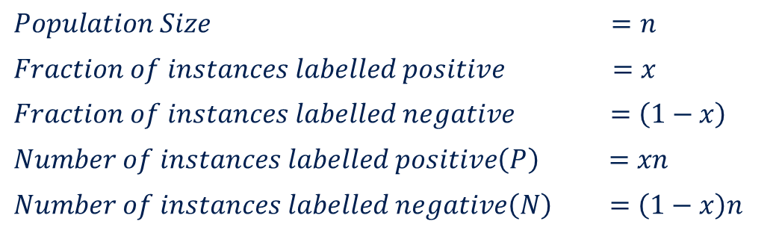
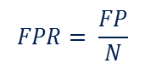
Model evaluation
$Population Size =n$
$Fraction of instances labelled positive =x$
$Fraction of instances labelled negative =\left(1−x\right)$
$Number of instances labelled positive\left(P\right) =xn$
$Number of instances labelled negative\left(N\right) =\left(1−x\right)n$
$$Accuracy= \frac{TP+TN}{n}$$
$$Recall= \frac{TP}{TP+FN}$$
$$Precision=\frac{TP}{TP+FP}$$
$$TPR=\frac{TP}{P}$$
$$FPR= \frac{FP}{N}$$
Github reference
Accuracy: how often your model is correct
Recall: how often were true positives actually predicted (cancer)
Precision: how many of YOUR positive predictions were right

Slide 27
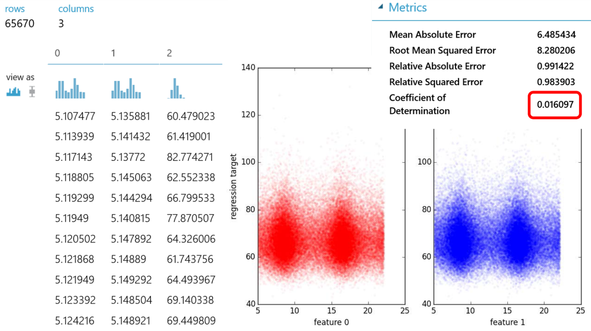

Slide 28
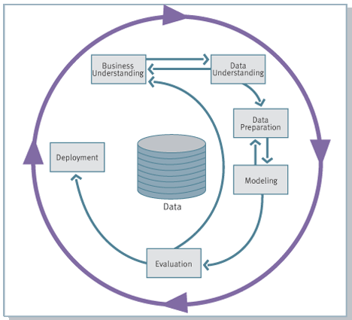
Common Data Science Pitfalls
Not setting expectations of fuzzy timelines
Fuzzy, ill-defined business use case
Not everything needs a predictive approach
Not having the right data
Not thinking about deployment
Tips
Make sure the BUSINESS is engaged
Document intended value

